Slide 1
Chapter 5: CPU Scheduling

Slide 2
Outline
Basic Concepts
Scheduling Criteria
Scheduling Algorithms
Thread Scheduling
Multi-Processor Scheduling
Real-Time CPU Scheduling
Operating Systems Examples
Algorithm Evaluation

Slide 3
Objectives
Describe various CPU scheduling algorithms
Assess CPU scheduling algorithms based on scheduling criteria
Explain the issues related to multiprocessor and multicore scheduling
Describe various real-time scheduling algorithms
Describe the scheduling algorithms used in the Windows, Linux, and Solaris operating systems
Apply modeling and simulations to evaluate CPU scheduling algorithms

Slide 4
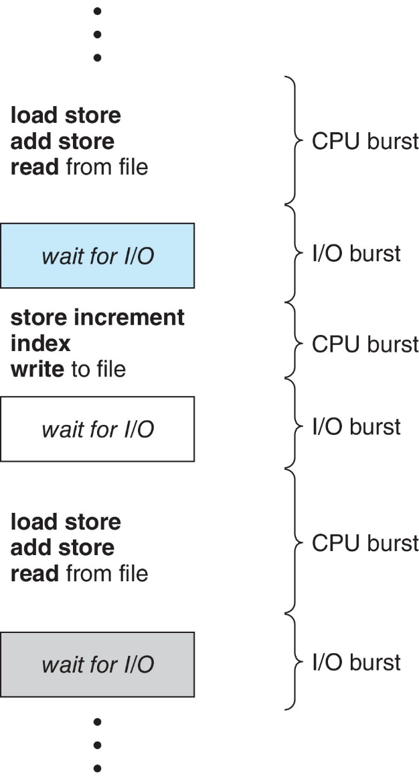
Basic Concepts
Maximum CPU utilization obtained with multiprogramming
CPU–I/O Burst Cycle – Process execution consists of a cycle of CPU execution and I/O wait
CPU burst followed by I/O burst
CPU burst distribution is of main concern

Slide 5
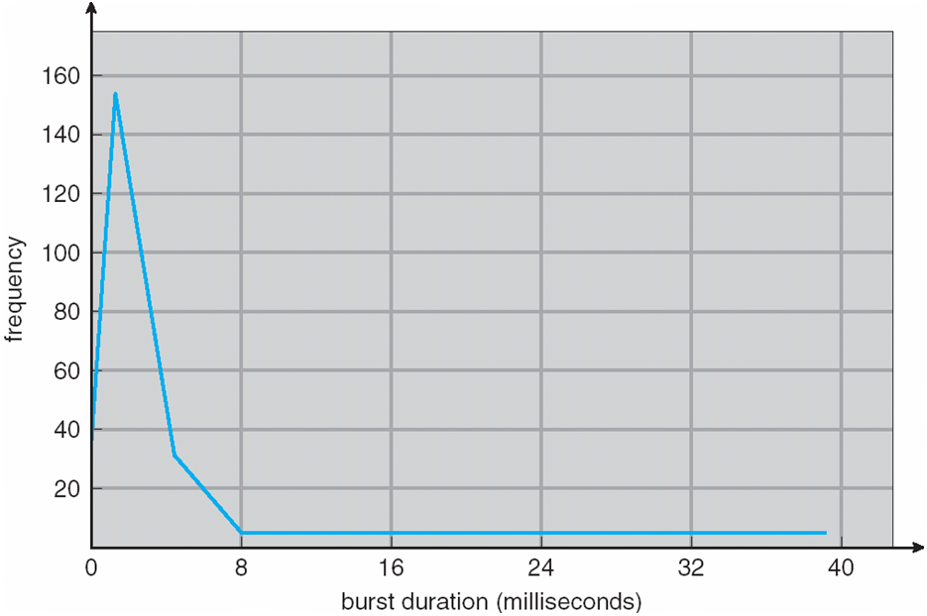
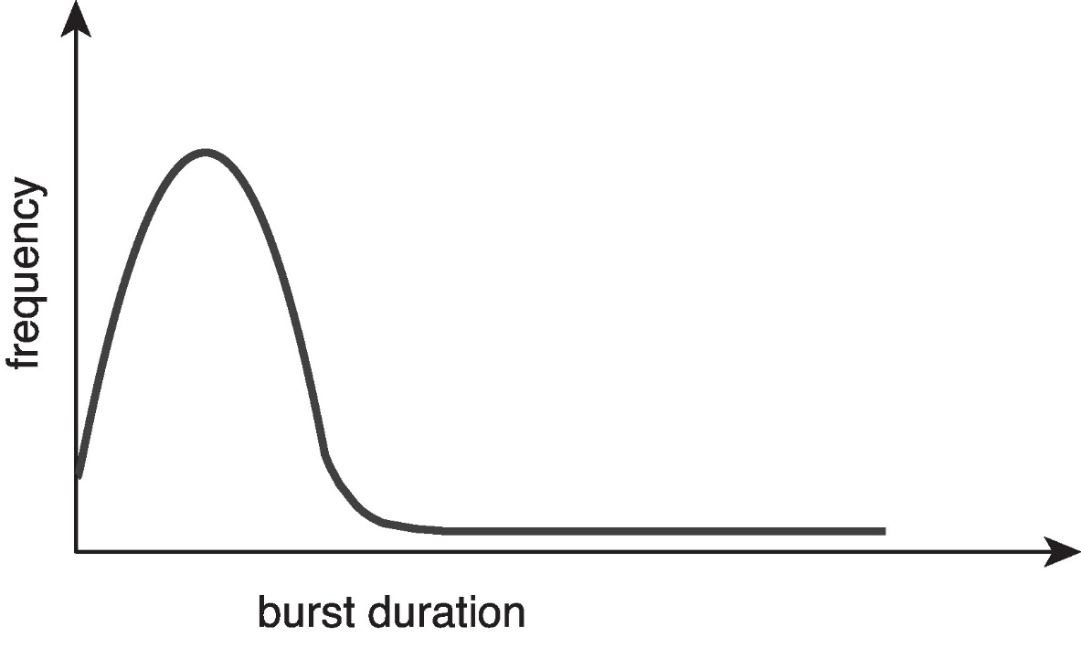
Histogram of CPU-burst Times
Large number of short bursts
Small number of longer bursts

Slide 6
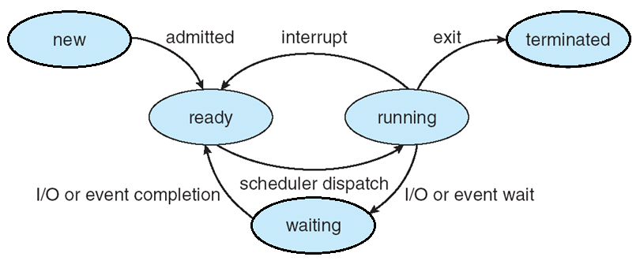
CPU Scheduler
The CPU scheduler selects from among the processes in ready queue, and allocates a CPU core to one of them
Queue may be ordered in various ways
CPU scheduling decisions may take place when a process:
1. Switches from running to waiting state
2. Switches from running to ready state
3. Switches from waiting to ready
4. Terminates
For situations 1 and 4, there is no choice in terms of scheduling. A new process (if one exists in the ready queue) must be selected for execution.
For situations 2 and 3, however, there is a choice.
4
2
3
1

Slide 7
Preemptive and Nonpreemptive Scheduling
When scheduling takes place only under circumstances 1 and 4, the scheduling scheme is nonpreemptive.
Otherwise, it is preemptive.
Under Nonpreemptive scheduling, once the CPU has been allocated to a process, the process keeps the CPU until it releases it either by terminating or by switching to the waiting state.
Virtually all modern operating systems including Windows, MacOS, Linux, and UNIX use preemptive scheduling algorithms.
Notes:
Tasklet
SoftIRQ
Work queue
https://www.itread01.com/p/1372963.html

Slide 8
Task States from µC/OSII

Slide 9
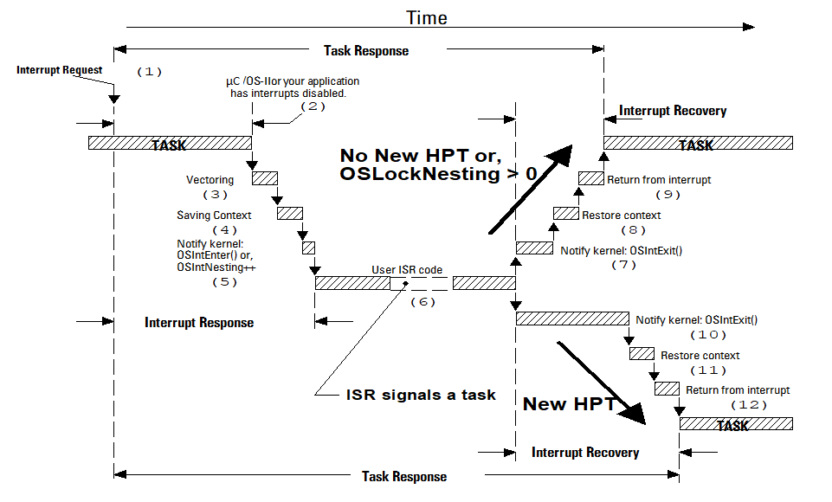
Servicing an Interrupt from µC/OSII

Slide 10
Preemptive Scheduling and Race Conditions
Preemptive scheduling can result in race conditions when data are shared among several processes.
Consider the case of two processes that share data. While one process is updating the data, it is preempted so that the second process can run. The second process then tries to read the data, which are in an inconsistent state.
This issue will be explored in detail in Chapter 6.

Slide 11
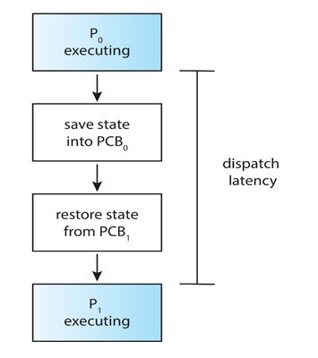
Dispatcher
Dispatcher module gives control of the CPU to the process selected by the CPU scheduler; this involves:
Switching context
Switching to user mode
Jumping to the proper location in the user program to restart that program
Dispatch latency – time it takes for the dispatcher to stop one process and start another running

Slide 12
Scheduling Criteria
CPU utilization – keep the CPU as busy as possible
Throughput – # of processes that complete their execution per time unit
Turnaround time – amount of time to execute a particular process
Waiting time – amount of time a process has been waiting in the ready queue
Response time – amount of time it takes from when a request was submitted until the first response is produced.
Notes:
Work conserving

Slide 13
Scheduling Algorithm Optimization Criteria
Max CPU utilization
Max throughput
Min turnaround time
Min waiting time
Min response time

Slide 14
First-Come, First-Served (FCFS) Scheduling
Process Burst Time
P₁ 24
P₂ 3
P₃ 3
Suppose that the processes arrive in the order: P₁ , P₂ , P₃ The Gantt Chart for the schedule is:
Waiting time for P₁ = 0; P₂ = 24; P₃ = 27
Average waiting time: (0 + 24 + 27)/3 = 17
P₁
P₂
P₃
0
24
27
30

Slide 15
FCFS Scheduling (Cont.)
Suppose that the processes arrive in the order
P₂ , P₃ , P₁
The Gantt chart for the schedule is:
Waiting time for P₁ = 6; P₂ = 0; P₃ = 3
Average waiting time: (6 + 0 + 3)/3 = 3
Much better than previous case
Convoy effect short process behind long process
Consider one CPU-bound and many I/O-bound processes
P₂
P₃
P₁
0
3
6
30

Slide 16
Shortest-Job-First (SJF) Scheduling
Associate with each process the length of its next CPU burst
Use these lengths to schedule the process with the shortest time
SJF is optimal – gives minimum average waiting time for a given set of processes
The difficulty is knowing the length of the next CPU request
Could ask the user

Slide 17
Shortest-Job-First (SJF) Scheduling
Associate with each process the length of its next CPU burst
Use these lengths to schedule the process with the shortest time
SJF is optimal – gives minimum average waiting time for a given set of processes
Preemptive version called shortest-remaining-time-first
How do we determine the length of the next CPU burst?
Could ask the user
Estimate

Slide 18
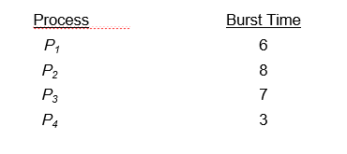
Example of SJF
SJF scheduling chart
Average waiting time = (3 + 16 + 9 + 0) / 4 = 7

Slide 19
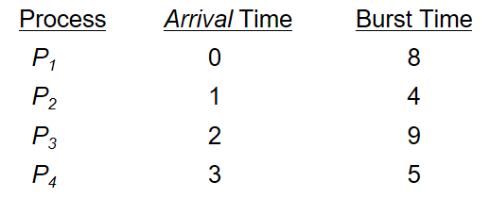
Example of Shortest-remaining-time-first
Now we add the concepts of varying arrival times and preemption to the analysis
Preemptive SJF Gantt Chart
Average waiting time = [(10-1)+(1-1)+(17-2)+(5-3)]/4 = 26/4 = 6.5

Slide 20
Example of Non-Preemptive SJF
Process Arrival Time Burst Time
P₁ 0.0 7
P₂ 2.0 4
P₃ 4.0 1
P₄ 5.0 4
SJF (non-preemptive)
Average waiting time = (0 + 6 + 3 + 7)/4 = 4
P₁
P₃
P₂
P₄
0
3
7
8
12
16

Slide 21
Example of Preemptive SJF
Process Arrival Time Burst Time
P₁ 0.0 7
P₂ 2.0 4
P₃ 4.0 1
P₄ 5.0 4
SJF (preemptive)
Average waiting time = (9 + 1 + 0 + 2)/4 = 3
P₁
P₂
P₃
P₂
P₄
P₁
0
2
4
5
7
11
16

Slide 22
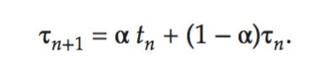
Determining Length of Next CPU Burst
Can only estimate the length – should be similar to the previous one
Then pick process with shortest predicted next CPU burst
Can be done by using the length of previous CPU bursts, using exponential averaging
Commonly, α set to ½

Slide 23
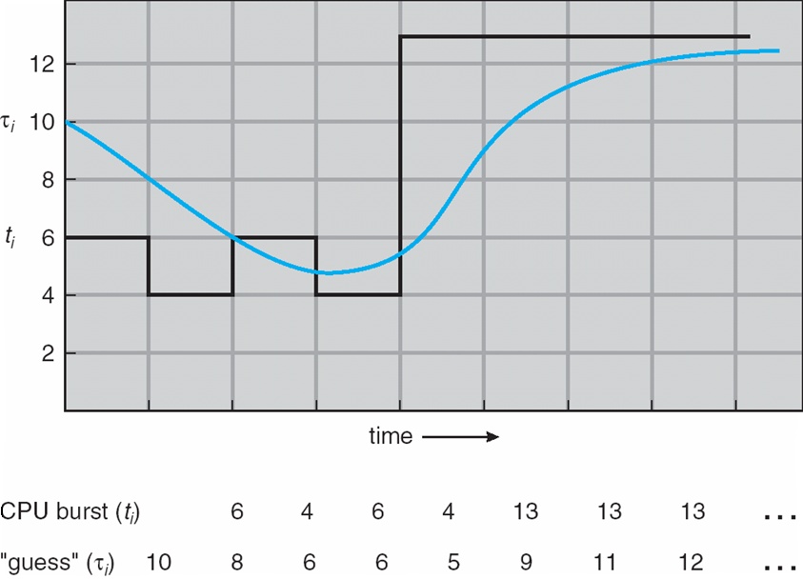
Prediction of the Length of the Next CPU Burst

Slide 24
Examples of Exponential Averaging
α =0
τ_{n+1} = τ_{n}
Recent history does not count
α =1
τ_{n+1} = α t_{n}
Only the actual last CPU burst counts
If we expand the formula, we get:
τ_{n+1} = α t_{n}+(1 - α)α t_{n} ₋₁ + …
+(1 - α )^{j} α t_{n} _{-j} + …
+(1 - α )^{n +1} τ₀
Since both α and (1 - α) are less than or equal to 1, each successive term has less weight than its predecessor

Slide 25
Round Robin (RR)
Each process gets a small unit of CPU time (time quantum q), usually 10-100 milliseconds. After this time has elapsed, the process is preempted and added to the end of the ready queue.
If there are n processes in the ready queue and the time quantum is q, then each process gets 1/n of the CPU time in chunks of at most q time units at once. No process waits more than (n-1)q time units.
Timer interrupts every quantum to schedule next process
Performance
q large ⇒ FIFO
q small ⇒ q must be large with respect to context switch, otherwise overhead is too high

Slide 26
Example of RR with Time Quantum = 4
Process Burst Time
P₁ 24
P₂ 3
P₃ 3
The Gantt chart is:
Typically, higher average turnaround than SJF, but better response
q should be large compared to context switch time
q usually 10 milliseconds to 100 milliseconds,
Context switch < 10 microseconds

Slide 27
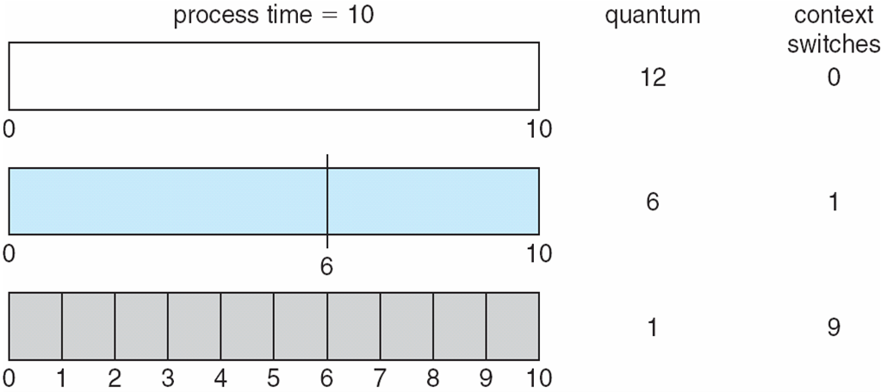
Time Quantum and Context Switch Time

Slide 28
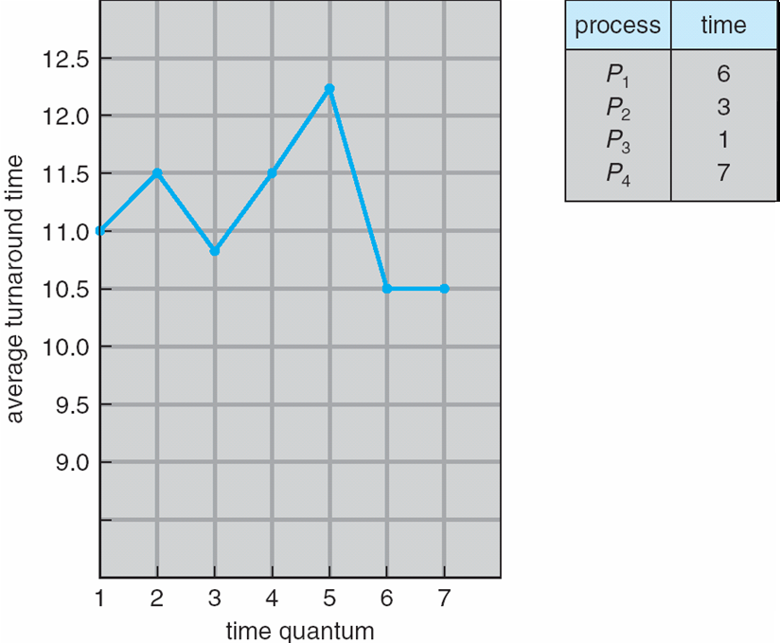
Turnaround Time Varies With The Time Quantum
Notes:
What is the ideal pattern?

Slide 29
Priority Scheduling
A priority number (integer) is associated with each process
The CPU is allocated to the process with the highest priority (smallest integer ≡ highest priority)
Preemptive
Nonpreemptive
SJF is priority scheduling where priority is the inverse of predicted next CPU burst time
Problem ≡ Starvation – low priority processes may never execute
Solution ≡ Aging – as time progresses increase the priority of the process

Slide 30
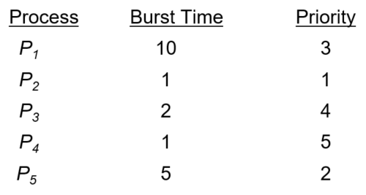
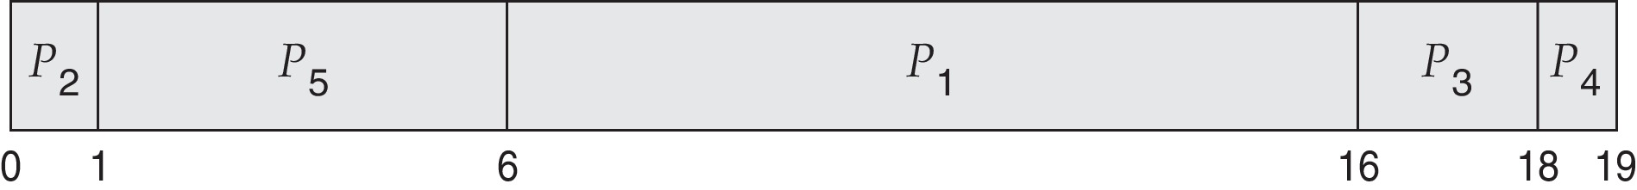
Example of Priority Scheduling
Priority scheduling Gantt Chart
Average waiting time = 8.2

Slide 31
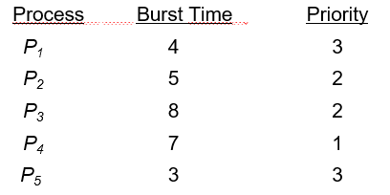
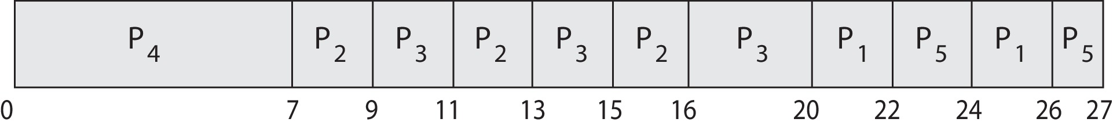
Priority Scheduling w/ Round-Robin
Run the process with the highest priority. Processes with the same priority run round-robin
Gantt Chart with time quantum = 2

Slide 32
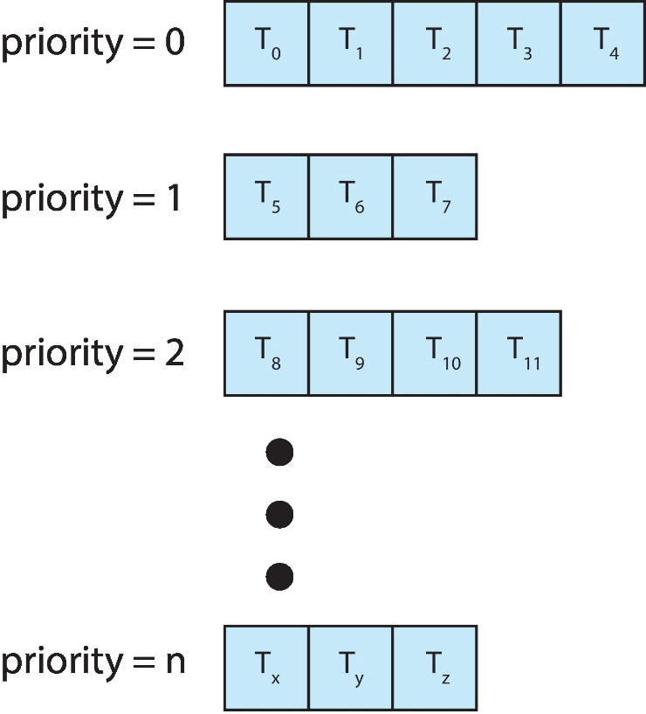
Multilevel Queue
With priority scheduling, have separate queues for each priority.
Schedule the process in the highest-priority queue!
Notes:
Ready queue is partitioned into separate queues: foreground (interactive) background (batch)
Each queue has its own scheduling algorithm
foreground – RR
background – FCFS
Scheduling must be done between the queues
Fixed priority scheduling; (i.e., serve all from foreground then from background). Possibility of starvation.
Time slice – each queue gets a certain amount of CPU time which it can schedule amongst its processes; i.e., 80% to foreground in RR
20% to background in FCFS

Slide 33
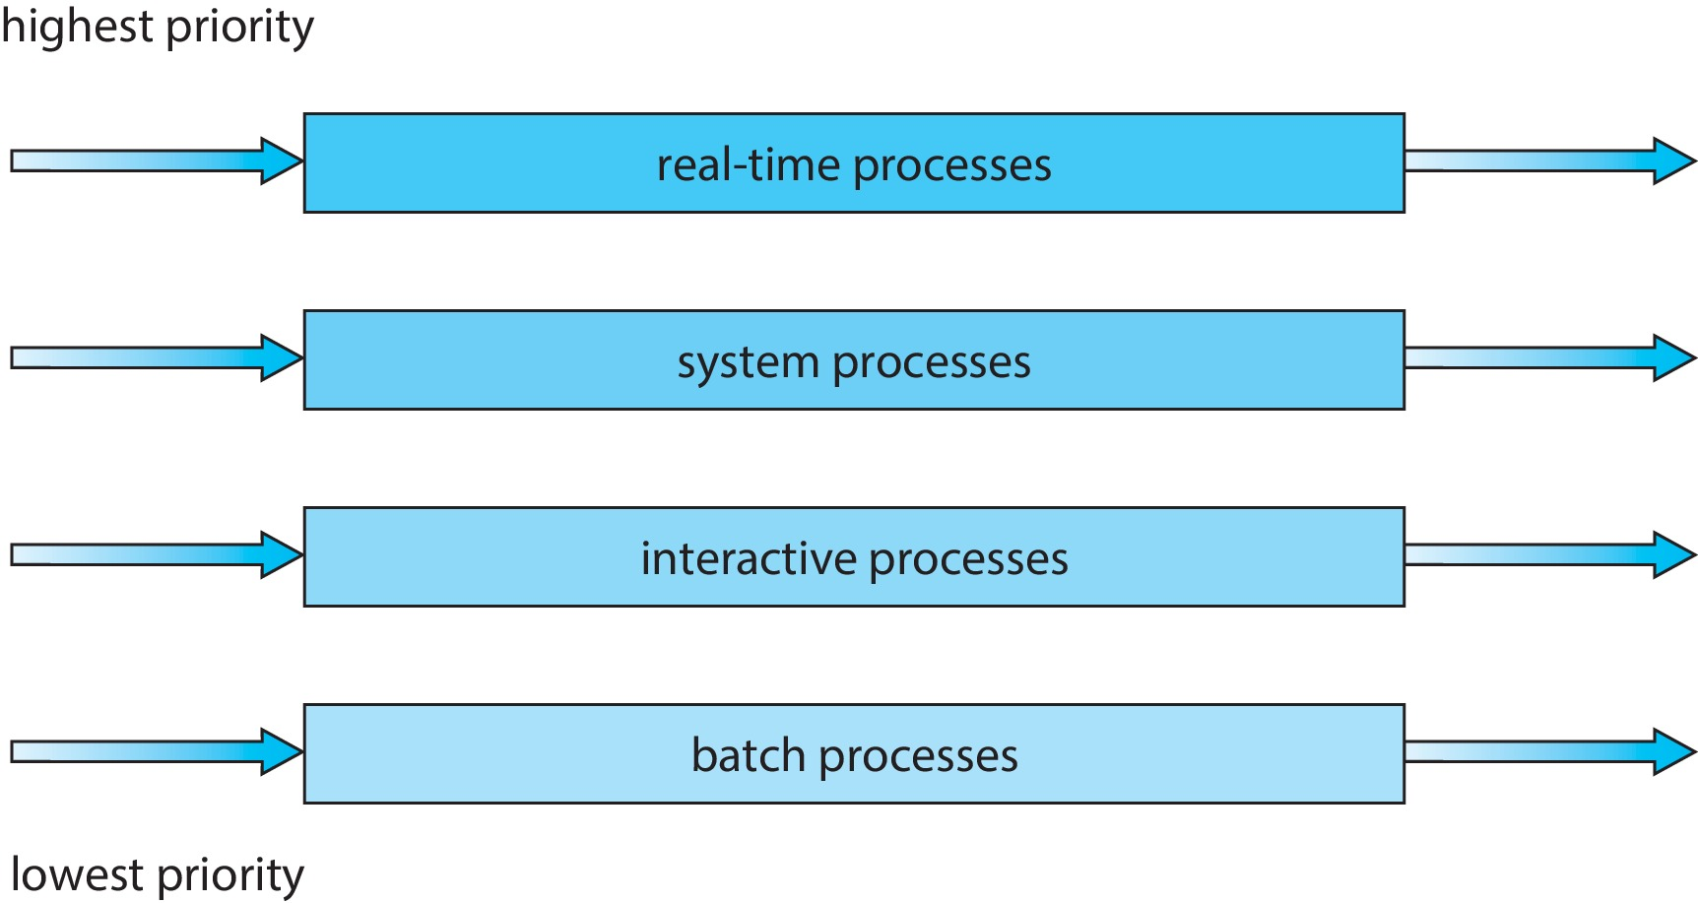
Multilevel Queue
Prioritization based upon process type

Slide 34
Multilevel Feedback Queue
A process can move between the various queues.
Multilevel-feedback-queue scheduler defined by the following parameters:
Number of queues
Scheduling algorithms for each queue
Method used to determine when to upgrade a process
Method used to determine when to demote a process
Method used to determine which queue a process will enter when that process needs service
Aging can be implemented using multilevel feedback queue

Slide 35
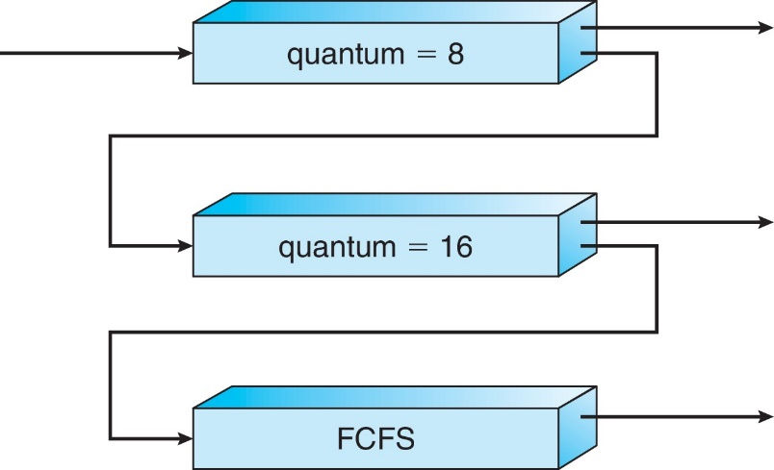
Example of Multilevel Feedback Queue
Three queues:
Q₀ – RR with time quantum 8 milliseconds
Q₁ – RR time quantum 16 milliseconds
Q₂ – FCFS
Scheduling
A new process enters queue Q₀ which is served in RR
When it gains CPU, the process receives 8 milliseconds
If it does not finish in 8 milliseconds, the process is moved to queue Q₁
At Q₁ job is again served in RR and receives 16 additional milliseconds
If it still does not complete, it is preempted and moved to queue Q₂

Slide 36
Thread Scheduling
Distinction between user-level and kernel-level threads
When threads supported, threads scheduled, not processes
Many-to-one and many-to-many models, thread library schedules user-level threads to run on LWP
Known as process-contention scope (PCS) since scheduling competition is within the process
Typically done via priority set by programmer
Kernel thread scheduled onto available CPU is system-contention scope (SCS) – competition among all threads in system

Slide 37
Pthread Scheduling
API allows specifying either PCS or SCS during thread creation
PTHREAD_SCOPE_PROCESS schedules threads using PCS scheduling
PTHREAD_SCOPE_SYSTEM schedules threads using SCS scheduling
Can be limited by OS – Linux and macOS only allow PTHREAD_SCOPE_SYSTEM

Slide 38
Pthread Scheduling API
#include <pthread.h>
#include <stdio.h>
#define NUM_THREADS 5
int main(int argc, char *argv[]) {
int i, scope; pthread_t tid[NUM THREADS];
pthread_attr_t attr;
/* get the default attributes */
pthread_attr_init(&attr);
/* first inquire on the current scope */ if (pthread_attr_getscope(&attr, &scope) != 0)
fprintf(stderr, "Unable to get scheduling scope\n");
else {
if (scope == PTHREAD_SCOPE_PROCESS)
printf("PTHREAD_SCOPE_PROCESS");
else if (scope == PTHREAD_SCOPE_SYSTEM)
printf("PTHREAD_SCOPE_SYSTEM");
else fprintf(stderr, "Illegal scope value.\n");
}

Slide 39
Pthread Scheduling API
/* set the scheduling algorithm to PCS or SCS */
pthread_attr_setscope(&attr, PTHREAD_SCOPE_SYSTEM);
/* create the threads */ for (i = 0; i < NUM_THREADS; i++)
pthread_create(&tid[i],&attr,runner,NULL);
/* now join on each thread */ for (i = 0; i < NUM_THREADS; i++)
pthread_join(tid[i], NULL);
}
/* Each thread will begin control in this function */
void *runner(void *param) {
/* do some work ... */
pthread_exit(0);
}

Slide 40
Multiple-Processor Scheduling
CPU scheduling more complex when multiple CPUs are available
Multiprocess may be any one of the following architectures:
Multicore CPUs
Multithreaded cores
NUMA systems
Heterogeneous multiprocessing

Slide 41
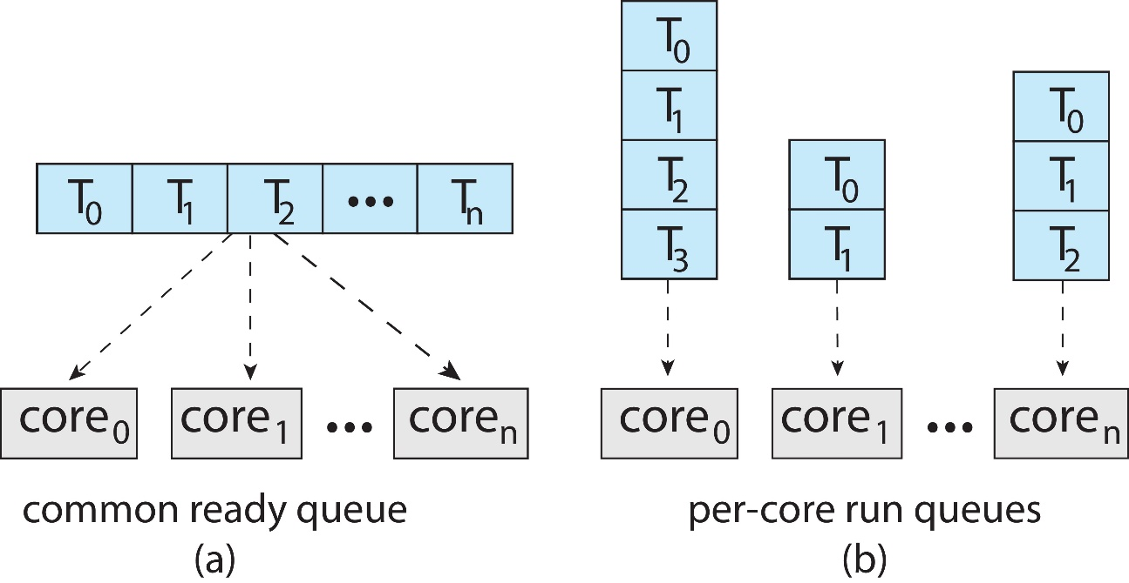
Multiple-Processor Scheduling
Symmetric multiprocessing (SMP) is where each processor is self scheduling.
All threads may be in a common ready queue (a)
Each processor may have its own private queue of threads (b)

Slide 42
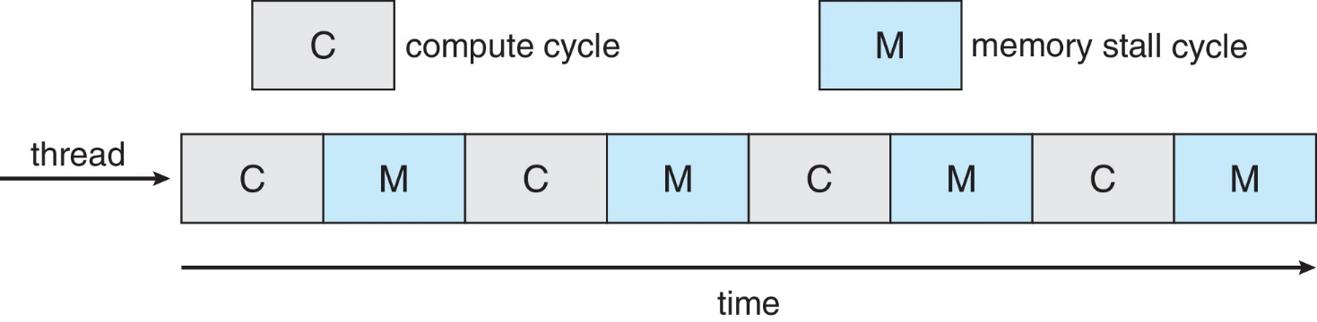
Multicore Processors
Recent trend to place multiple processor cores on same physical chip
Faster and consumes less power
Multiple threads per core also growing
Takes advantage of memory stall to make progress on another thread while memory retrieve happens

Slide 43
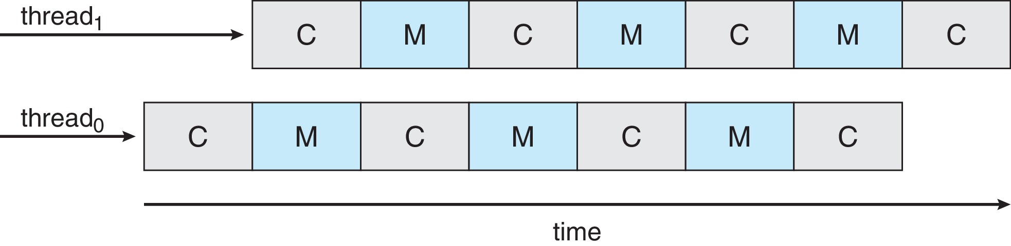
Multithreaded Multicore System
Each core has > 1 hardware threads.
If one thread has a memory stall, switch to another thread!

Slide 44
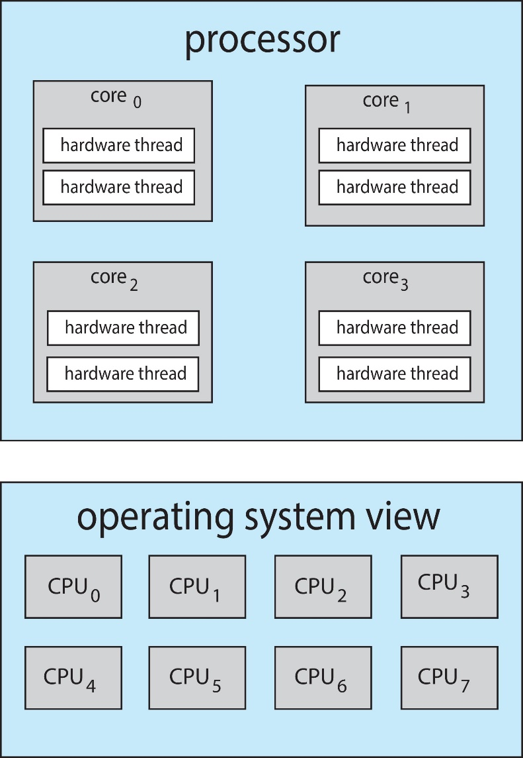
Multithreaded Multicore System
Chip-multithreading (CMT) assigns each core multiple hardware threads. (Intel refers to this as hyperthreading.)
On a quad-core system with 2 hardware threads per core, the operating system sees 8 logical processors.

Slide 45
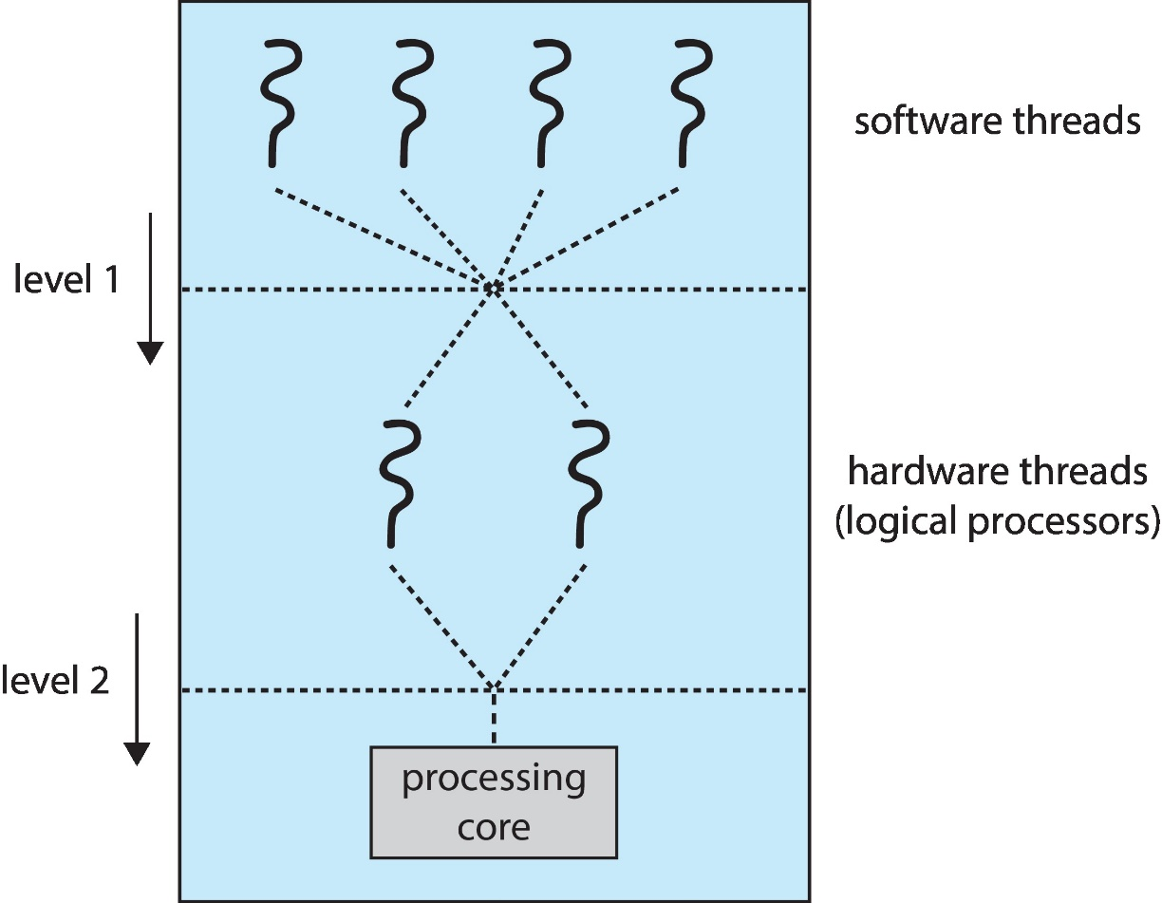
Multithreaded Multicore System
Two levels of scheduling:
The operating system deciding which software thread to run on a logical CPU
How each core decides which hardware thread to run on the physical core.

Slide 46
Multiple-Processor Scheduling – Load Balancing
If SMP, need to keep all CPUs loaded for efficiency
Load balancing attempts to keep workload evenly distributed
Push migration – periodic task checks load on each processor, and if found pushes task from overloaded CPU to other CPUs
Pull migration – idle processors pulls waiting task from busy processor

Slide 47
Multiple-Processor Scheduling – Processor Affinity
When a thread has been running on one processor, the cache contents of that processor stores the memory accesses by that thread.
We refer to this as a thread having affinity for a processor (i.e., “processor affinity”)
Load balancing may affect processor affinity as a thread may be moved from one processor to another to balance loads, yet that thread loses the contents of what it had in the cache of the processor it was moved off of.
Soft affinity – the operating system attempts to keep a thread running on the same processor, but no guarantees.
Hard affinity – allows a process to specify a set of processors it may run on.

Slide 48
NUMA and CPU Scheduling
If the operating system is NUMA-aware, it will assign memory closes to the CPU the thread is running on.

Slide 49
Real-Time CPU Scheduling
Can present obvious challenges
Soft real-time systems – Critical real-time tasks have the highest priority, but no guarantee as to when tasks will be scheduled
Hard real-time systems – task must be serviced by its deadline

Slide 50
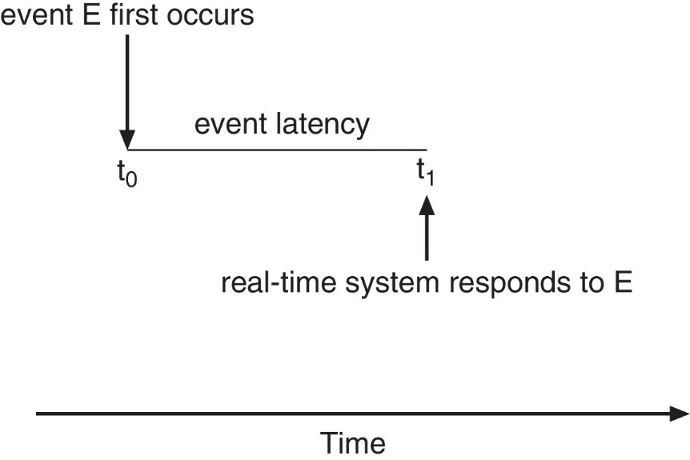
Real-Time CPU Scheduling
Event latency – the amount of time that elapses from when an event occurs to when it is serviced.
Two types of latencies affect performance
Interrupt latency – time from arrival of interrupt to start of routine that services interrupt
Dispatch latency – time for schedule to take current process off CPU and switch to another

Slide 51
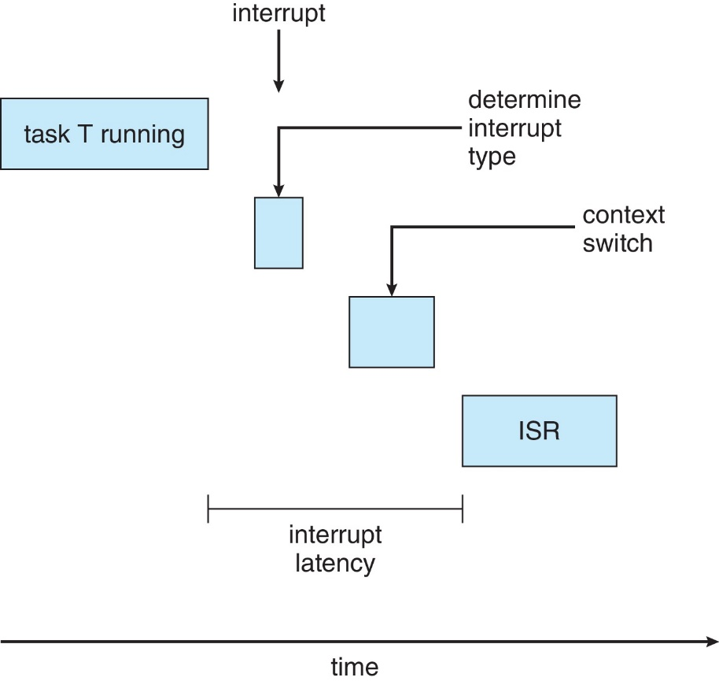
Interrupt Latency

Slide 52
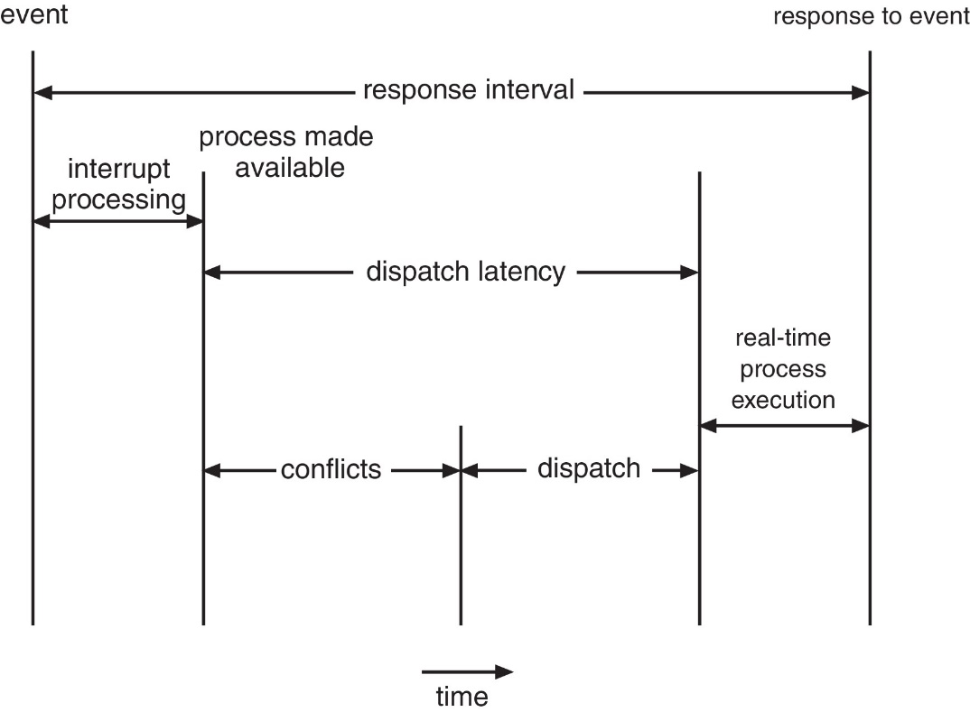
Dispatch Latency
Conflict phase of dispatch latency:
Preemption of any process running in kernel mode
Release by low-priority process of resources needed by high-priority processes

Slide 53
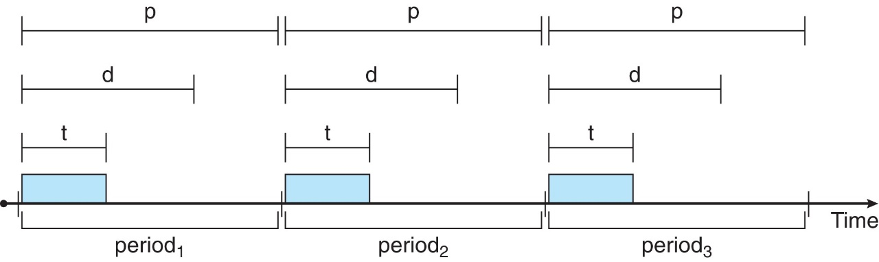
Priority-based Scheduling
For real-time scheduling, scheduler must support preemptive, priority-based scheduling
But only guarantees soft real-time
For hard real-time must also provide ability to meet deadlines
Processes have new characteristics: periodic ones require CPU at constant intervals
Has processing time t, deadline d, period p
0 ≤ t ≤ d ≤ p
Rate of periodic task is 1/p

Slide 54
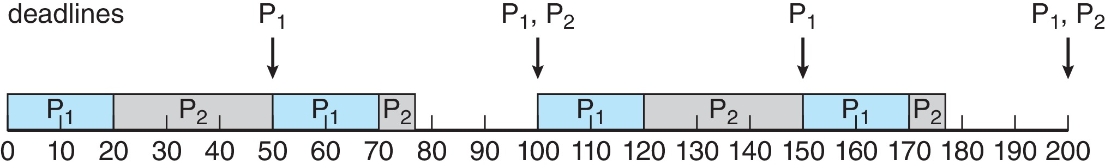
Rate Monotonic Scheduling
A priority is assigned based on the inverse of its period
Shorter periods = higher priority;
Longer periods = lower priority
P₁ is assigned a higher priority than P₂.

Slide 55
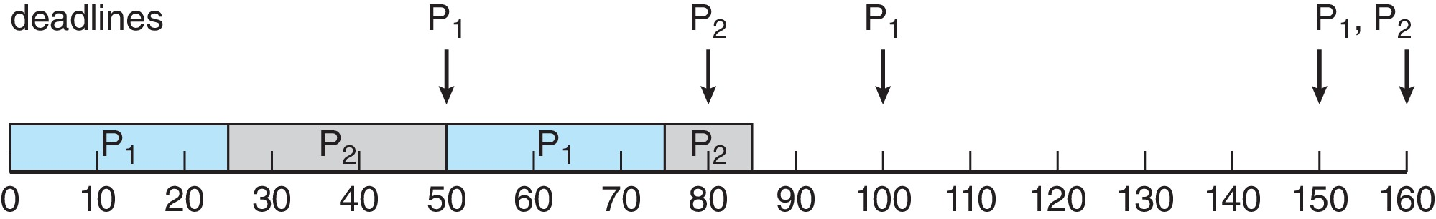
Missed Deadlines with Rate Monotonic Scheduling
Process P2 misses finishing its deadline at time 80

Slide 56
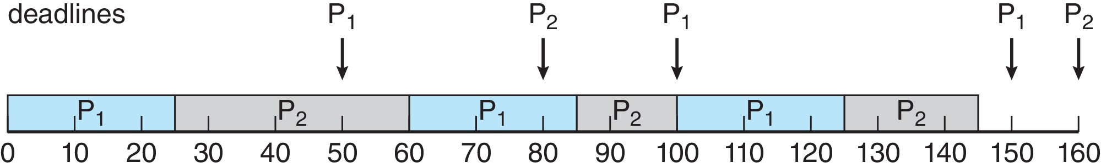
Earliest Deadline First Scheduling (EDF)
Priorities are assigned according to deadlines: the earlier the deadline, the higher the priority;
the later the deadline, the lower the priority

Slide 57
Proportional Share Scheduling
T shares are allocated among all processes in the system
An application receives N shares where N < T
This ensures each application will receive N / T of the total processor time

Slide 58
POSIX Real-Time Scheduling
The POSIX.1b standard
API provides functions for managing real-time threads
Defines two scheduling classes for real-time threads:
SCHED_FIFO - threads are scheduled using a FCFS strategy with a FIFO queue. There is no time-slicing for threads of equal priority
SCHED_RR - similar to SCHED_FIFO except time-slicing occurs for threads of equal priority
Defines two functions for getting and setting scheduling policy:
pthread_attr_getsched_policy(pthread_attr_t *attr, int *policy)
pthread_attr_setsched_policy(pthread_attr_t *attr, int policy)

Slide 59
POSIX Real-Time Scheduling API
#include <pthread.h>
#include <stdio.h>
#define NUM_THREADS 5
int main(int argc, char *argv[])
{
int i, policy; pthread_t_tid[NUM_THREADS];
pthread_attr_t attr;
/* get the default attributes */
pthread_attr_init(&attr);
/* get the current scheduling policy */ if (pthread_attr_getschedpolicy(&attr, &policy) != 0)
fprintf(stderr, "Unable to get policy.\n");
else {
if (policy == SCHED_OTHER) printf("SCHED_OTHER\n");
else if (policy == SCHED_RR) printf("SCHED_RR\n");
else if (policy == SCHED_FIFO) printf("SCHED_FIFO\n");
}

Slide 60
POSIX Real-Time Scheduling API (Cont.)
/* set the scheduling policy - FIFO, RR, or OTHER */ if (pthread_attr_setschedpolicy(&attr, SCHED_FIFO) != 0)
fprintf(stderr, "Unable to set policy.\n");
/* create the threads */ for (i = 0; i < NUM_THREADS; i++)
pthread_create(&tid[i],&attr,runner,NULL);
/* now join on each thread */ for (i = 0; i < NUM_THREADS; i++)
pthread_join(tid[i], NULL);
}
/* Each thread will begin control in this function */
void *runner(void *param) {
/* do some work ... */
pthread_exit(0);
}

Slide 61
Operating System Examples
Linux scheduling
Windows scheduling
Solaris scheduling

Slide 62
Linux Scheduling Through Version 2.5
Prior to kernel version 2.5, ran variation of standard UNIX scheduling algorithm
Version 2.5 moved to constant order O(1) scheduling time
Preemptive, priority based
Two priority ranges: time-sharing and real-time
Real-time range from 0 to 99 and nice value from 100 to 140
Map into global priority with numerically lower values indicating higher priority
Higher priority gets larger q
Task run-able as long as time left in time slice (active)
If no time left (expired), not run-able until all other tasks use their slices
All run-able tasks tracked in per-CPU runqueue data structure
Two priority arrays (active, expired)
Tasks indexed by priority
When no more active, arrays are exchanged
Worked well, but poor response times for interactive processes

Slide 63
Linux Scheduling in Version 2.6.23 +
Completely Fair Scheduler (CFS)
Scheduling classes
Each has specific priority
Scheduler picks highest priority task in highest scheduling class
Rather than quantum based on fixed time allotments, based on proportion of CPU time
Two scheduling classes included, others can be added
default
real-time

Slide 64
Linux Scheduling in Version 2.6.23 + (Cont.)
Quantum calculated based on nice value from -20 to +19
Lower value is higher priority
Calculates target latency – interval of time during which task should run at least once
Target latency can increase if say number of active tasks increases
CFS scheduler maintains per task virtual run time in variable vruntime
Associated with decay factor based on priority of task – lower priority is higher decay rate
Normal default priority yields virtual run time = actual run time
To decide next task to run, scheduler picks task with lowest virtual run time

Slide 65
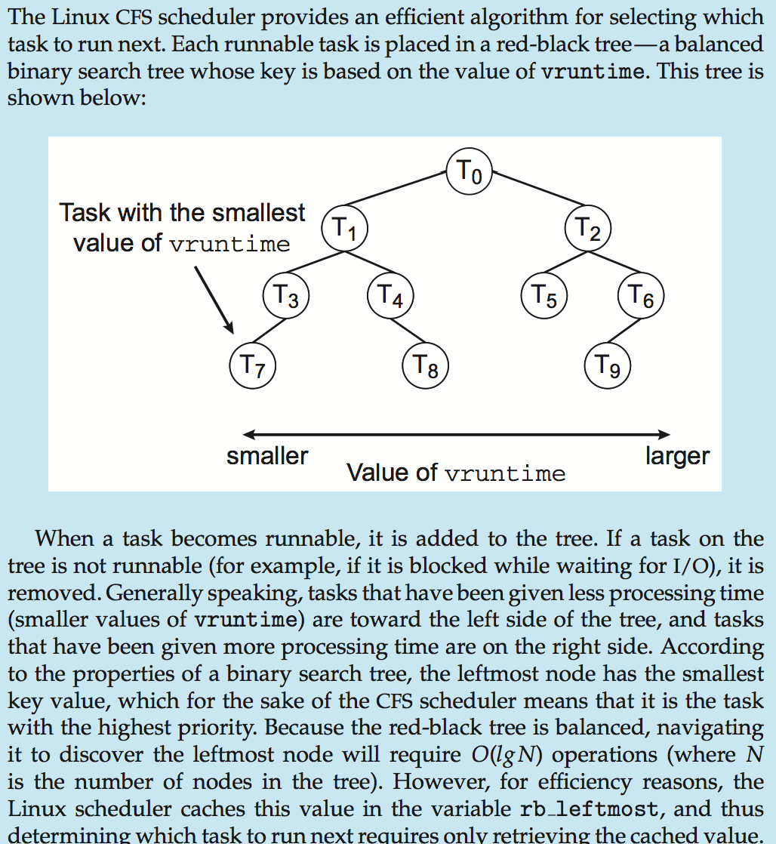
CFS Performance

Slide 66
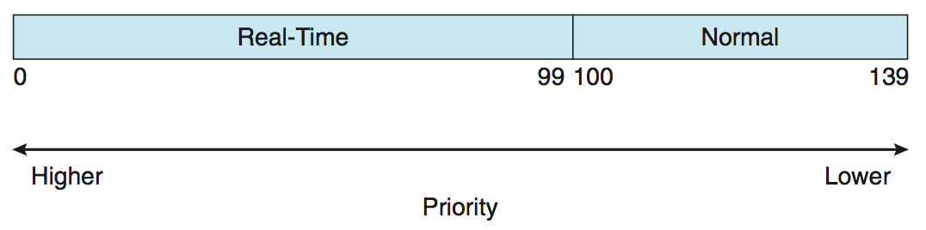
Linux Scheduling (Cont.)
Real-time scheduling according to POSIX.1b
Real-time tasks have static priorities
Real-time plus normal map into global priority scheme
Nice value of -20 maps to global priority 100
Nice value of +19 maps to priority 139
nice
-20
19

Slide 67
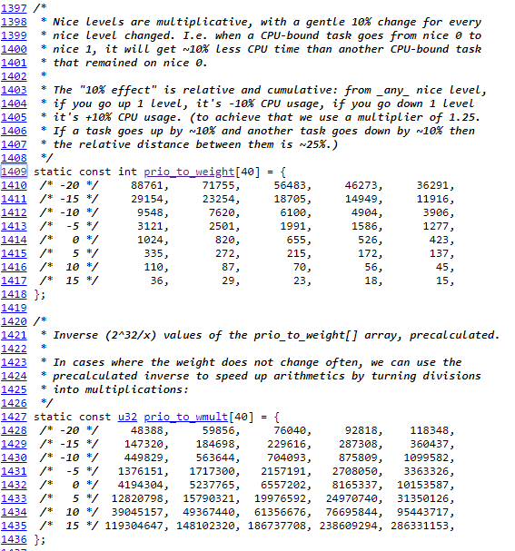

Slide 68
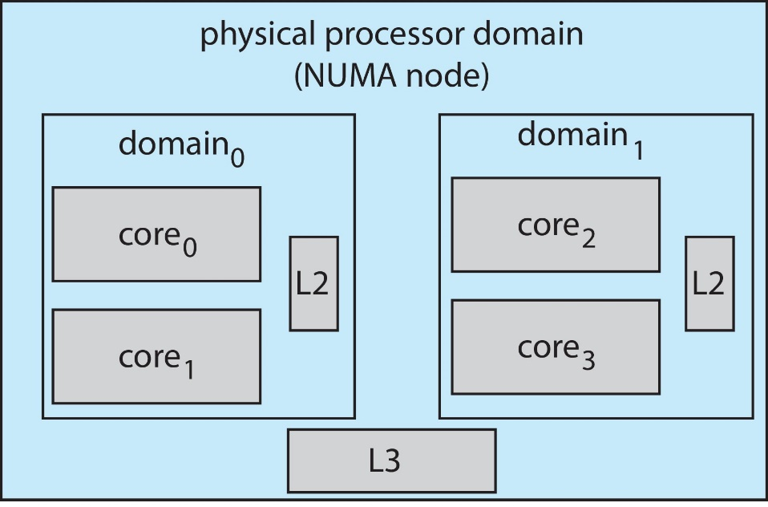
Linux Scheduling (Cont.)
Linux supports load balancing, but is also NUMA-aware.
Scheduling domain is a set of CPU cores that can be balanced against one another.
Domains are organized by what they share (i.e., cache memory.) Goal is to keep threads from migrating between domains.

Slide 69
Windows Scheduling
Windows uses priority-based preemptive scheduling
Highest-priority thread runs next
Dispatcher is scheduler
Thread runs until (1) blocks, (2) uses up time slice, (3) preempted by higher-priority thread
Real-time threads can preempt non-real-time
32-level priority scheme
Variable class is 1-15, real-time class is 16-31
Priority 0 is memory-management thread
Queue for each priority
If no run-able thread, runs idle thread

Slide 70
Windows Priority Classes
Win32 API identifies several priority classes to which a process can belong
REALTIME_PRIORITY_CLASS, HIGH_PRIORITY_CLASS, ABOVE_NORMAL_PRIORITY_CLASS,NORMAL_PRIORITY_CLASS, BELOW_NORMAL_PRIORITY_CLASS, IDLE_PRIORITY_CLASS
All are variable except REALTIME
A thread within a given priority class has a relative priority
TIME_CRITICAL, HIGHEST, ABOVE_NORMAL, NORMAL, BELOW_NORMAL, LOWEST, IDLE
Priority class and relative priority combine to give numeric priority
Base priority is NORMAL within the class
If quantum expires, priority lowered, but never below base

Slide 71
Windows Priority Classes (Cont.)
If wait occurs, priority boosted depending on what was waited for
Foreground window given 3x priority boost
Windows 7 added user-mode scheduling (UMS)
Applications create and manage threads independent of kernel
For large number of threads, much more efficient
UMS schedulers come from programming language libraries like C++ Concurrent Runtime (ConcRT) framework

Slide 72
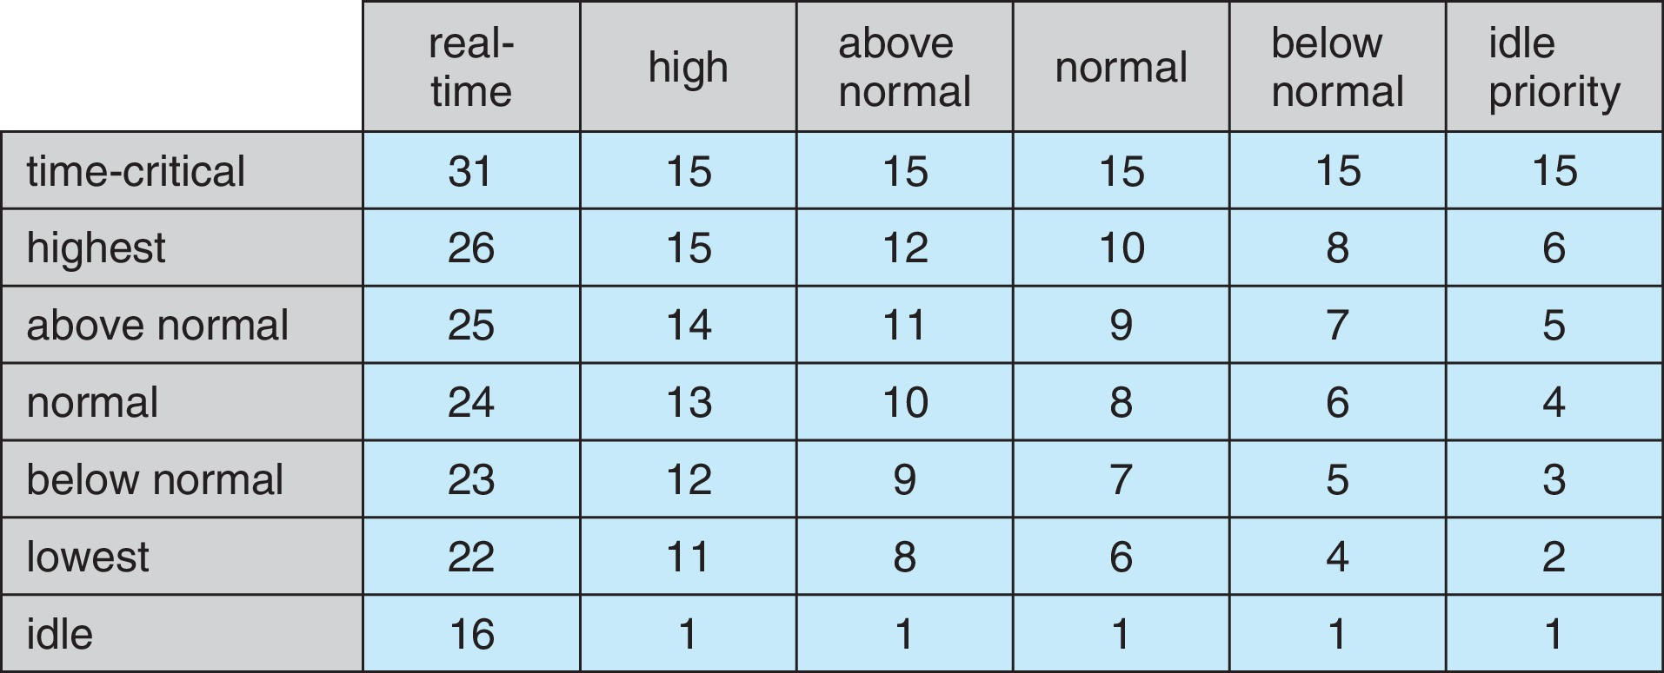
Windows Priorities

Slide 73
Solaris
Priority-based scheduling
Six classes available
Time sharing (default) (TS)
Interactive (IA)
Real time (RT)
System (SYS)
Fair Share (FSS)
Fixed priority (FP)
Given thread can be in one class at a time
Each class has its own scheduling algorithm
Time sharing is multi-level feedback queue
Loadable table configurable by sysadmin

Slide 74
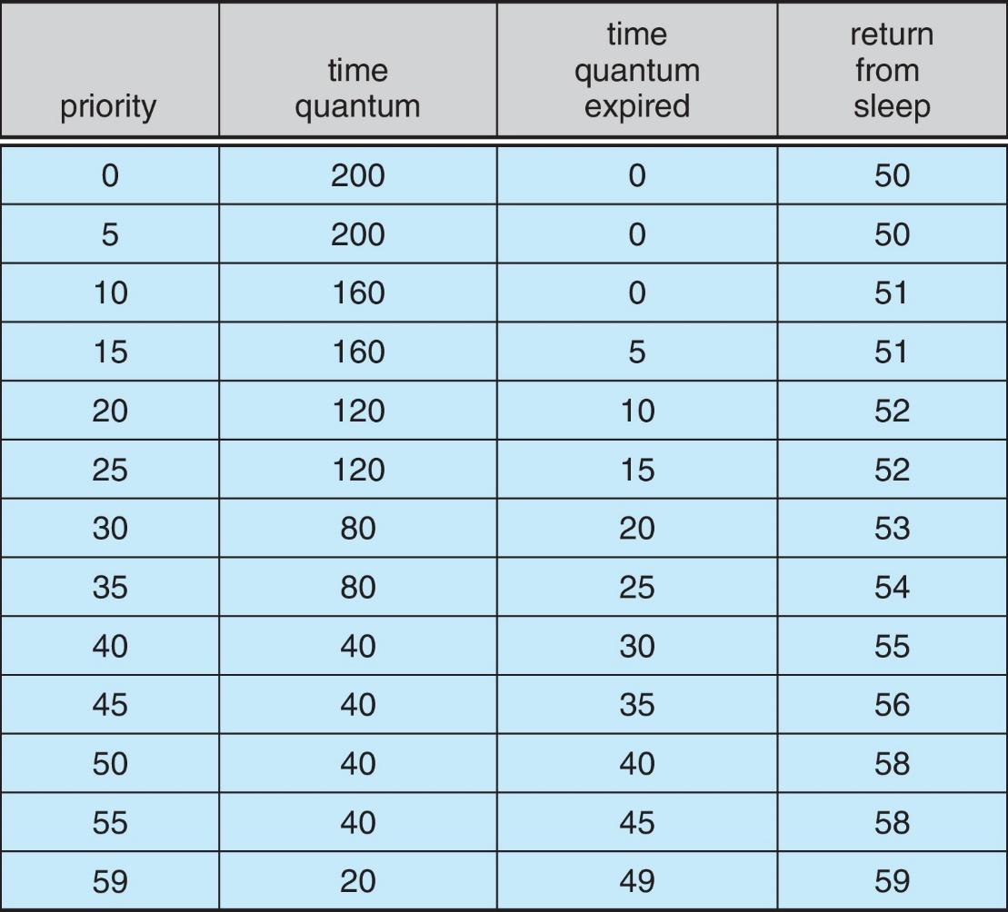
Solaris Dispatch Table

Slide 75
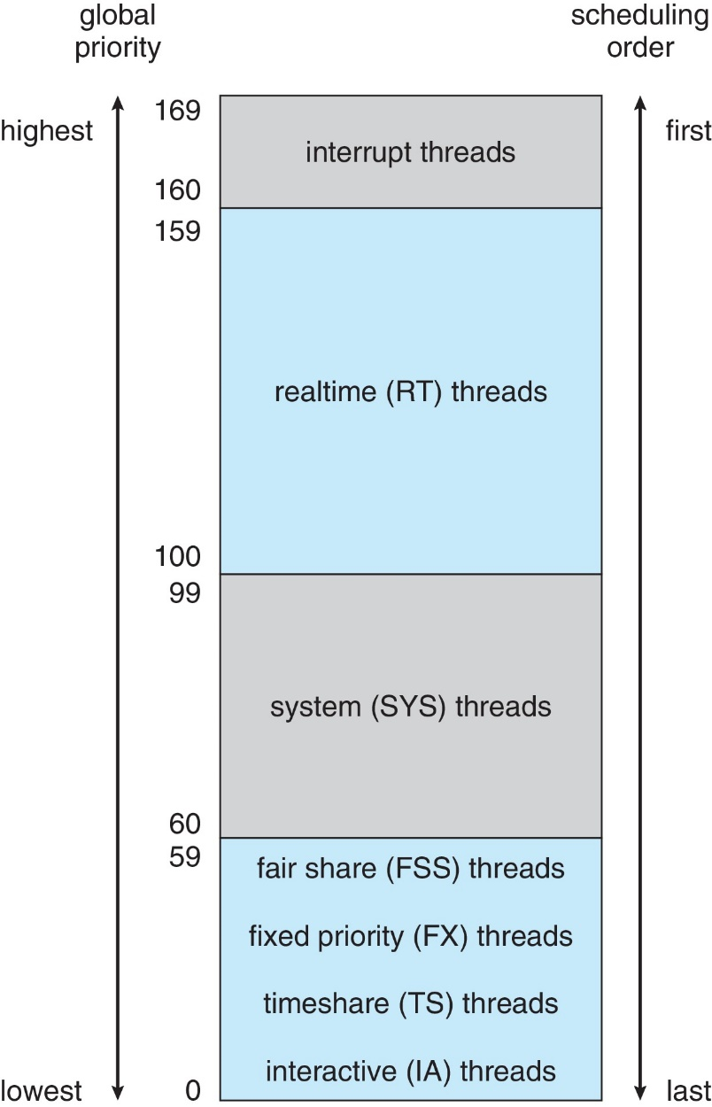
Solaris Scheduling

Slide 76
Solaris Scheduling (Cont.)
Scheduler converts class-specific priorities into a per-thread global priority
Thread with highest priority runs next
Runs until (1) blocks, (2) uses time slice, (3) preempted by higher-priority thread
Multiple threads at same priority selected via RR

Slide 77
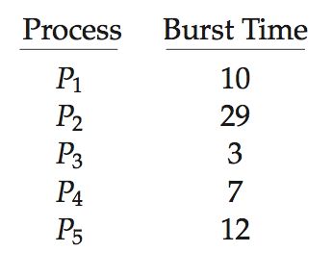
Algorithm Evaluation
How to select CPU-scheduling algorithm for an OS?
Determine criteria, then evaluate algorithms
Deterministic modeling
Type of analytic evaluation
Takes a particular predetermined workload and defines the performance of each algorithm for that workload
Consider 5 processes arriving at time 0:

Slide 78
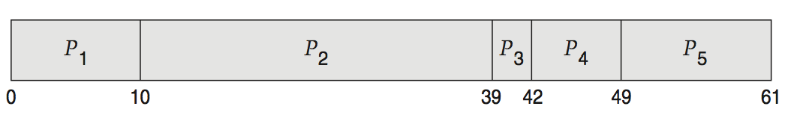
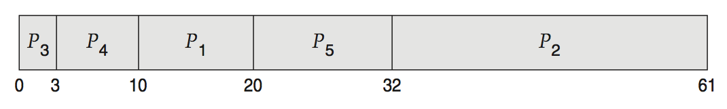
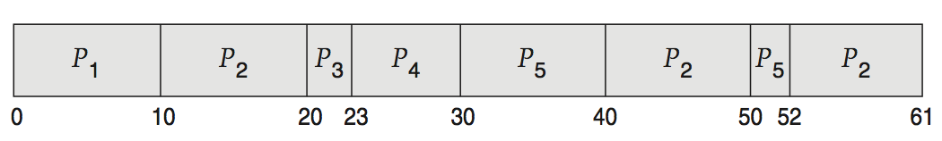
Deterministic Evaluation
For each algorithm, calculate minimum average waiting time
Simple and fast, but requires exact numbers for input, applies only to those inputs
FCFS is 28ms:
Non-preemptive SJF is 13ms:
RR is 23ms:

Slide 79
Queueing Models
Describes the arrival of processes, and CPU and I/O bursts probabilistically
Commonly exponential, and described by mean
Computes average throughput, utilization, waiting time, etc
Computer system described as network of servers, each with queue of waiting processes
Knowing arrival rates and service rates
Computes utilization, average queue length, average wait time, etc

Slide 80
Little’s Formula
n = average queue length
W = average waiting time in queue
λ = average arrival rate into queue
Little’s law – in steady state, processes leaving queue must equal processes arriving, thus: n = λ x W
Valid for any scheduling algorithm and arrival distribution
For example, if on average 7 processes arrive per second, and normally 14 processes in queue, then average wait time per process = 2 seconds

Slide 81
Simulations
Queueing models limited
Simulations more accurate
Programmed model of computer system
Clock is a variable
Gather statistics indicating algorithm performance
Data to drive simulation gathered via
Random number generator according to probabilities
Distributions defined mathematically or empirically
Trace tapes record sequences of real events in real systems

Slide 82
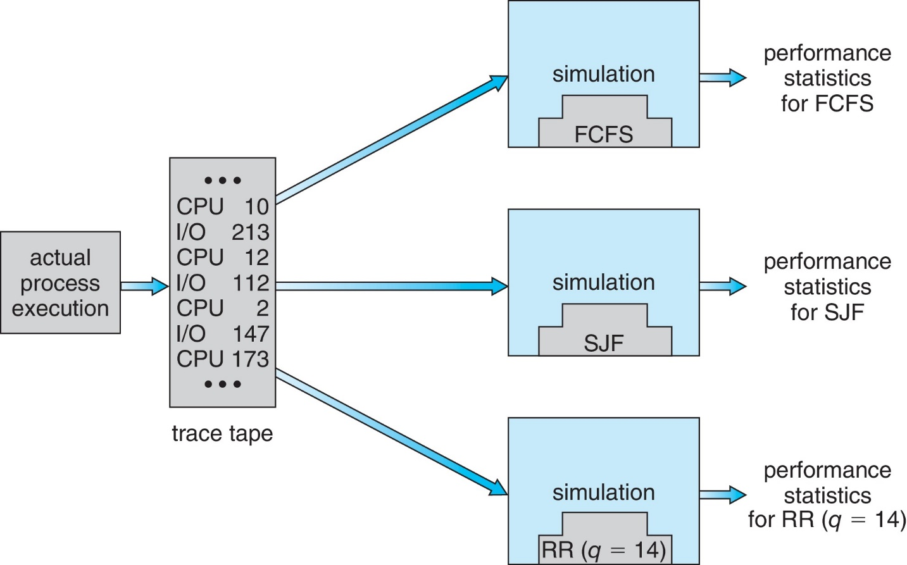
Evaluation of CPU Schedulers by Simulation

Slide 83
Implementation
Even simulations have limited accuracy
Just implement new scheduler and test in real systems
High cost, high risk
Environments vary
Most flexible schedulers can be modified per-site or per-system
Or APIs to modify priorities
But again environments vary

Slide 84
Different Ways of Doing Research
Data | faked/made | real
faked/virtual | simulation | emulation
real | evaluation | implementation
Platform

Slide 85
End of Chapter 5

Slide 86
Real-Time Scheduling
Hard real-time systems – required to complete a critical task within a guaranteed amount of time
Soft real-time computing – requires that critical processes receive priority over less fortunate ones
Firm real-time computing – the timing constraints can be changed on-line

Slide 87
Real-Time Systems
Value
Deadline
Soft RTS
Hard RTS
FirmRTS
Time
-Value

Slide 88
Real-Time Task Model
Periodic Task Model
parameters are known a priori
request time ready time
deadline
start
finish
preempt
resume
period
worst-case execution time
Predictability vs. Schedulability
high predictability and schedulability
easy-to-check schedulability condition
Admission Control, Rate

Slide 89
Scheduling Approaches
Time-Driven Scheduling Approach
widely used
inflexible, efficient
large space needed
e.g. cyclic executive
Priority-Driven Scheduling Approach
dynamic-priority
e.g. earliest deadline first
fixed-priority
e.g. rate monotonic

Slide 90
Periodic Real-Time Schedulers
Earliest Deadline First : optimal dynamic-priority scheduler
job with earlier deadline gets higher priority
schedulability condition
ρ (Τ) = ≤ 1
Rate Monotonic : optimal fixed-priority scheduler
job with smaller period gets higher priority
schedulability condition
ρ (Τ) ≤ n (2^{1/n}- 1)
n→∞, ㏑2 ≅ 0.69

Slide 91
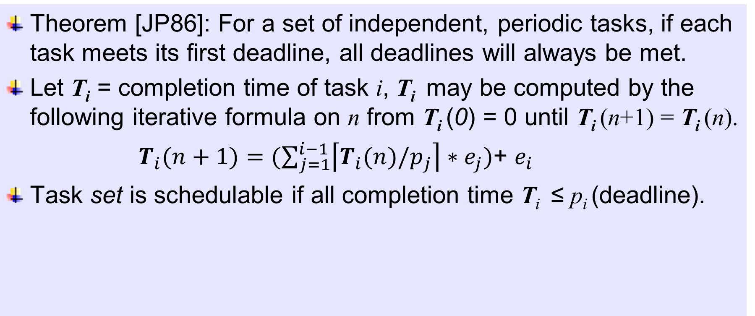
Completion Time (CT) Test
Theorem [JP86]: For a set of independent, periodic tasks, if each task meets its first deadline, all deadlines will always be met.
Let T_{i} = completion time of task i, T_{i} may be computed by the following iterative formula on n from T_{i} (0) = 0 until T_{i} (n+1) = T_{i} (n).
$T_{i}(n+1)=(\sum_{j=1}^{i−1}{\left\lceil T_{i}(n)/p_{j}\right\rceil ∗e_{j}})$+ $e_{i}$
Task set is schedulable if all completion time T_{i} ≤ p_{i} (deadline).
[JP86] Joseph and Pandya, “Finding Response Times in a Real-Time System”, BCS Computing Journal, vol 29, no.5, 1986, pp390-395

